Slide 1


Top 1000 IMDb Movies (1920-2020)
THE “KRITICS” REVIEW

Slide 2
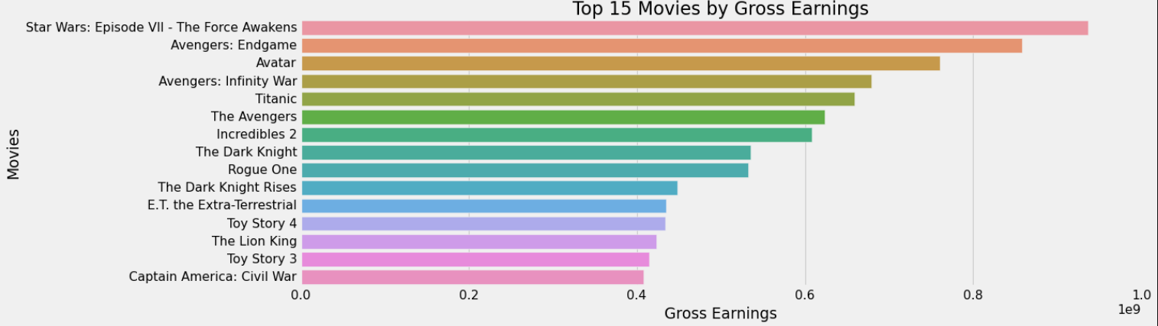






Gross Earnings Analysis
Useful for:
General Public (shortlist movies’ by top earnings).
To analyze what storyline and movie type people tend to watch more

Slide 3
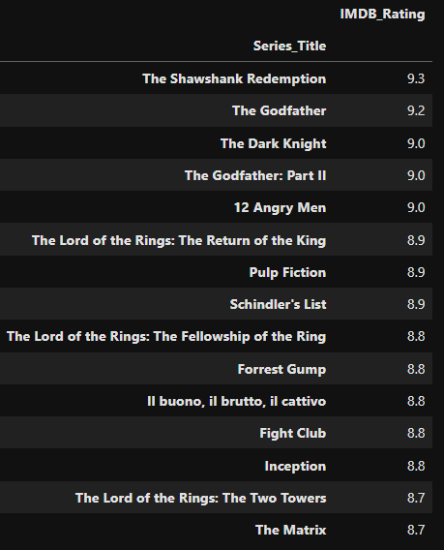





IMDb Rating Analysis
Useful for:
1. General Public (shortlist movies’ by top IMDb ratings).

Slide 4
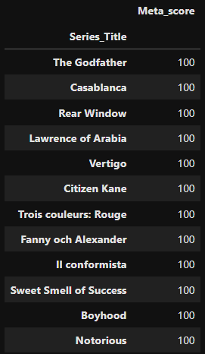
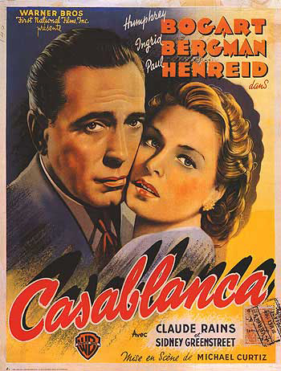
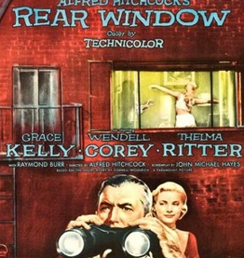
Meta score Analysis
Useful for:
1. General Public (shortlist movies’ by top meta score).
Movies with 100 Meta score

Slide 5
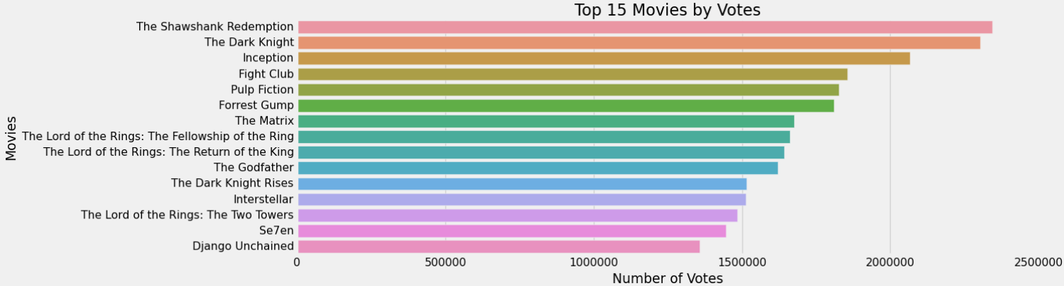



Votes Analysis
Useful for:
General Public (shortlist movies’ by top votes).
Movie Industry: Target such types of movies which get more votes

Slide 6
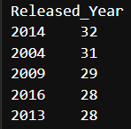
Released Year Analysis
Useful for:
1. General Public (shortlist movies’ by year).
Movies appear to have a better chance of making it to the top list compared to those released in the 1900s.
The dataset reveals that most of the movies are recent releases, and the bar graph (in the next slide) shows that the data is left-skewed. This suggests that movies released in recent years are more likely to rank among the top 1000 highest-rated movies or TV series.

Slide 7
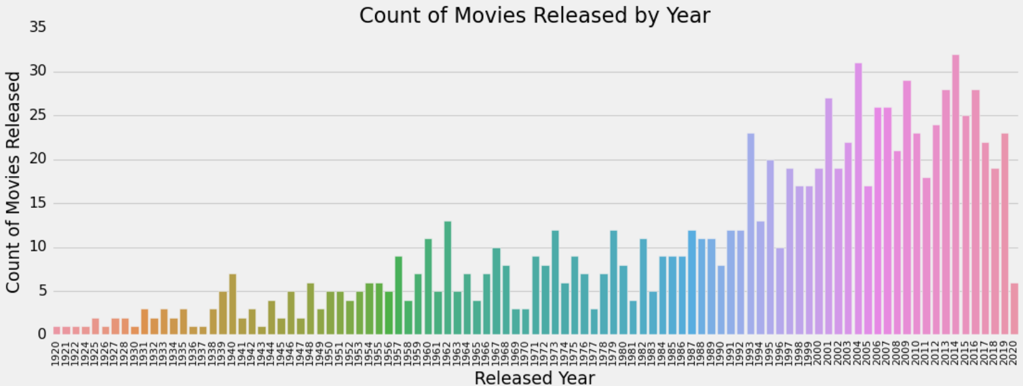
Released Year Analysis
Useful for:
1. General Public (shortlist movies’ by year).
Most of the movies are recent releases, and the bar graph shows that the data is left-skewed. Movies released in recent years are more likely to rank among the top 1000 highest-rated movies or TV series.

Slide 8
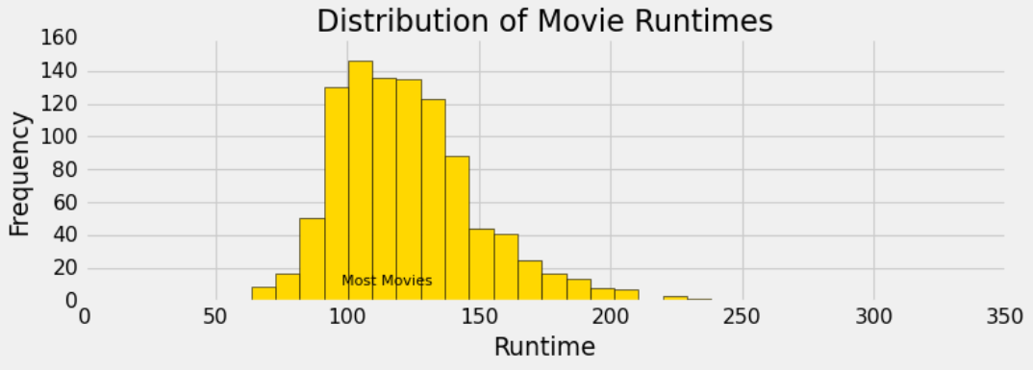
Runtime Analysis
Useful for:
1. Movie industry: Targeting runtimes within range
Directors and producers should focus on making movies which are too short or not too long. The sweet spot is within 100 – 140 minutes.

Slide 9
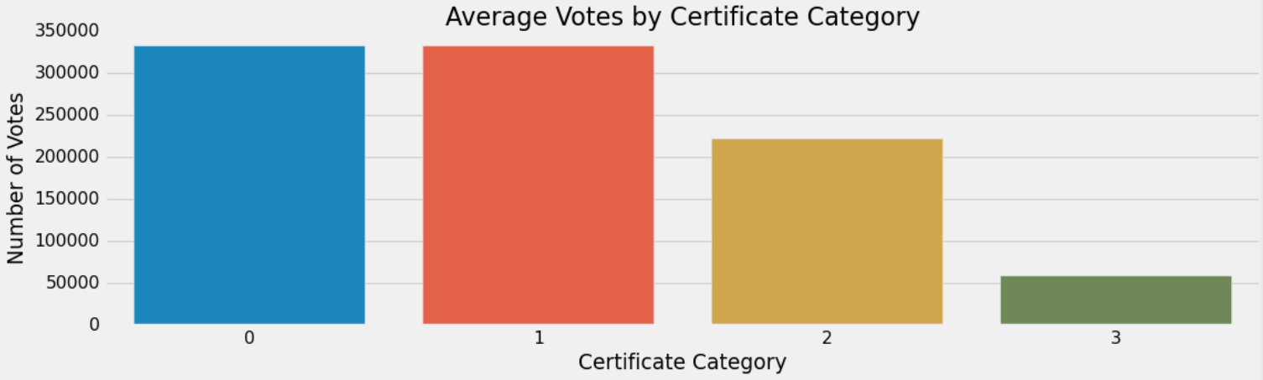
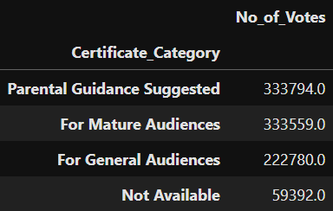
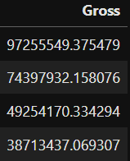
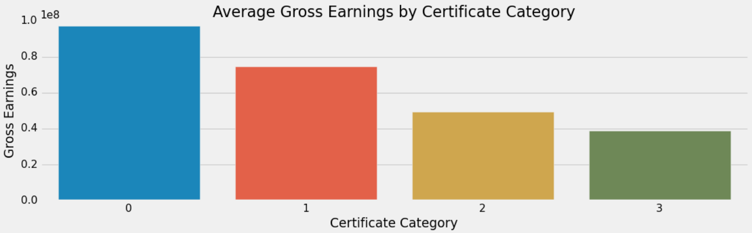
Certificate Analysis by Votes & Gross
Useful for:
Movies Industry: Target top 2 categories
Parental Guidance Suggested & Mature Audience certificate categories are similar with average number of votes and gross earnings per movie and tops the chart.
Parental Guide Suggested
For Mature Audiences
For General Audiences
Not Available

Slide 10
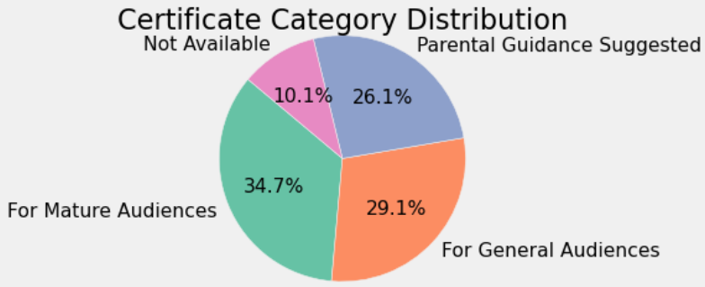
Certificate Category Analysis
Useful for:
1. General Public (shortlist movies’ by top categories).
2. Movie Industry: Category preferences to work with
Of the 4 types of certification categories, 'Mature Audience' category tops the list with 34.7% or 347 movies of the total 1000 movies.

Slide 11
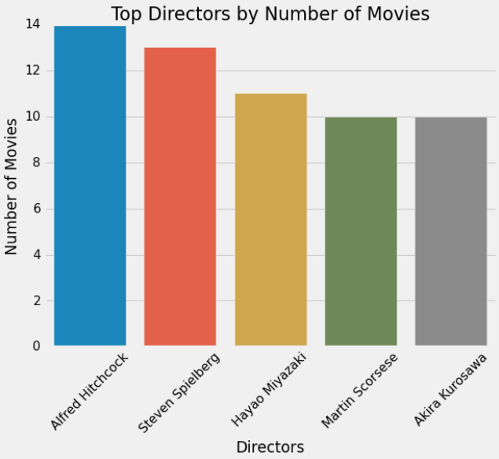
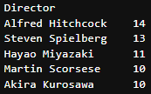
Directors Analysis
Useful for:
1. General Public (shortlist movies’ by top directors).
2. Movie Industry: Director preferences to work with
Top 5 Directors with their movie counts that made to the Top 1000 movies of all time until 2020.

Slide 12
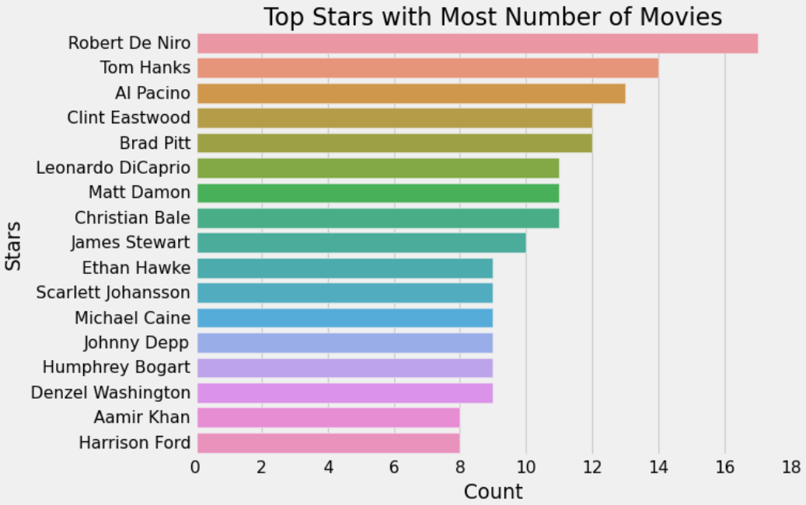
Top Stars Analysis
Useful for:
1. General Public (shortlist movies’ by top stars).
2. Movie Industry: Actor preferences to work with
Combining Star1, Star2, Star3, Star4

Slide 13
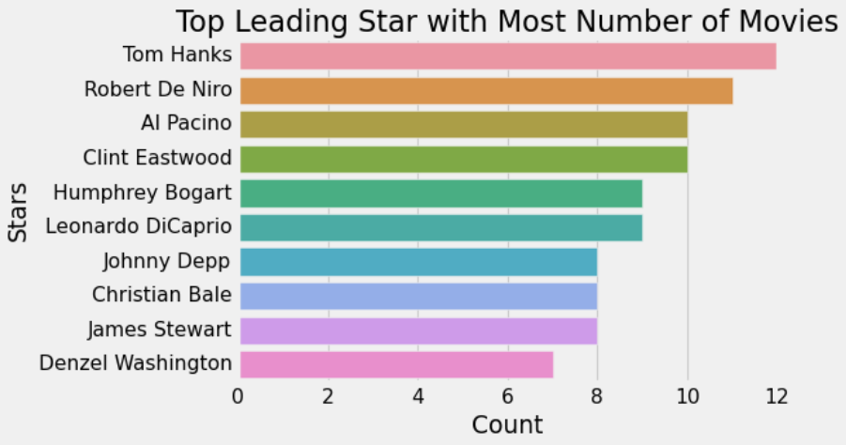
Top Lead Stars Analysis
Useful for:
1. General Public (shortlist movies’ by top stars.
2. Movie Industry: Actor preferences to work with
Only Star1

Slide 14
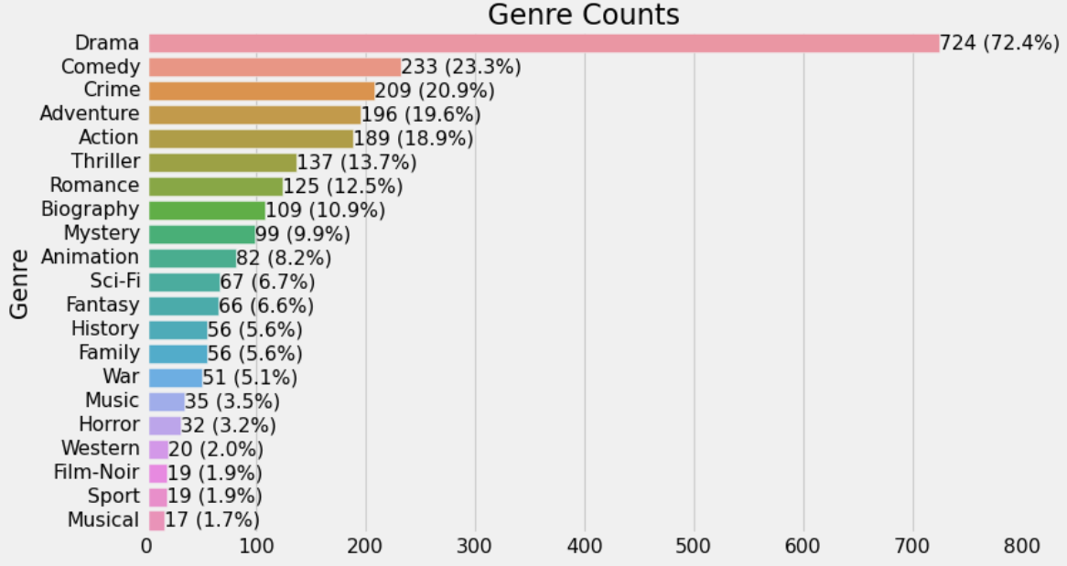
Genre Analysis
Note: The count of Genres are more than 1000 (total movies in the dataset) because most of the movies has multiple genres.
Useful for:
1. General Public (shortlist movies’ by top genres).
2. Movie Industry: Genre preferences to work with
Of the 1000 movies, 724 movies of them had Drama genre which clearly indicates the general public preference towards that particular genre. Comedy and Crime movies also have distribution more than 20%.

Slide 15

CONCLUSION
Useful for Movies Industry
Runtime:
100-140 minutes
Certificate Category:
1. Mature Audience
2. PG Suggested
Genre:
1. Drama
2. Comedy
3. Crime
Focusing on the all these variables together would pose a better chance to get in the top 1000 movies of all time.
The sweet spot

Slide 16

THE “KRITICS” REVIEW
Thank You!
Analysis by Bikash Gupta
LinkedIn
Data Collection from:
"Data beats emotions."
– Sean Rad

